Slide 1
Chapter 15: WebSphere MQ

Slide 2
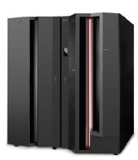
Chapter objectives
Be able to:
Explain why messaging and queuing is used
Describe the asynchronous flow of messages
Explain the function of a queue manager
List three zSeries-related adapters

Slide 3
Key terms in this chapter
local queue
channel
message-driven
MQI
asynchronous application
dead-letter queue
QM
remote queue
syncpoint

Slide 4
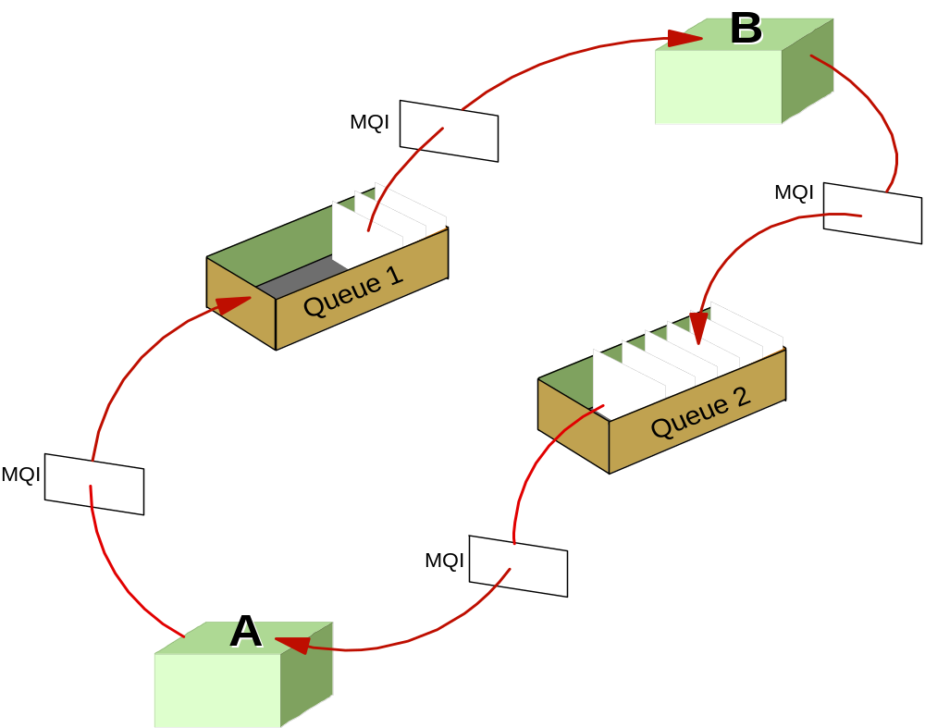
Synchronous communication model

Slide 5
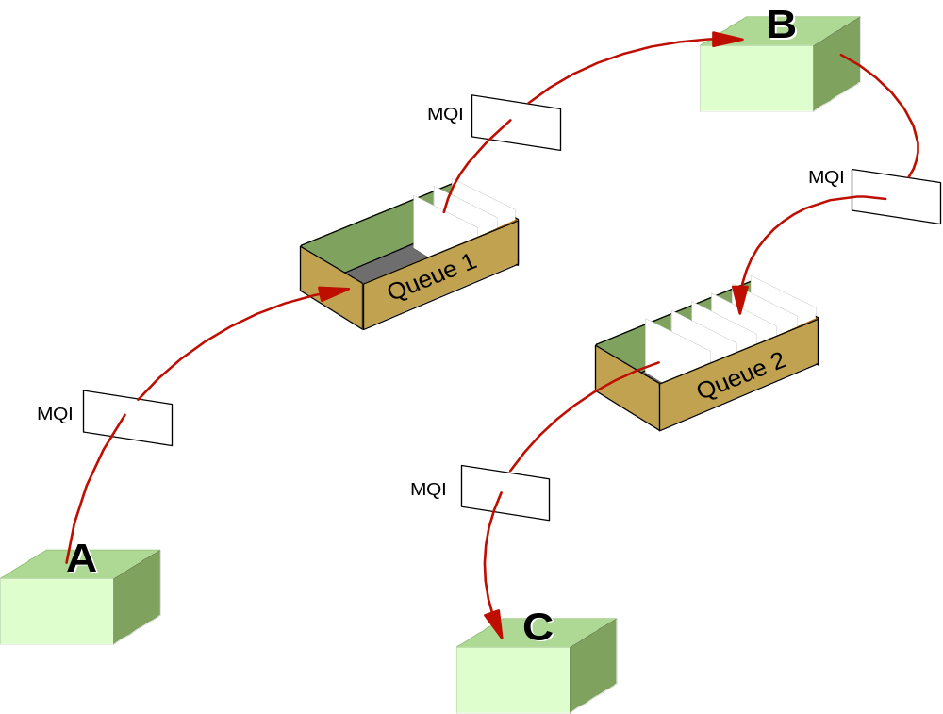
Asynchronous communication model

Slide 6
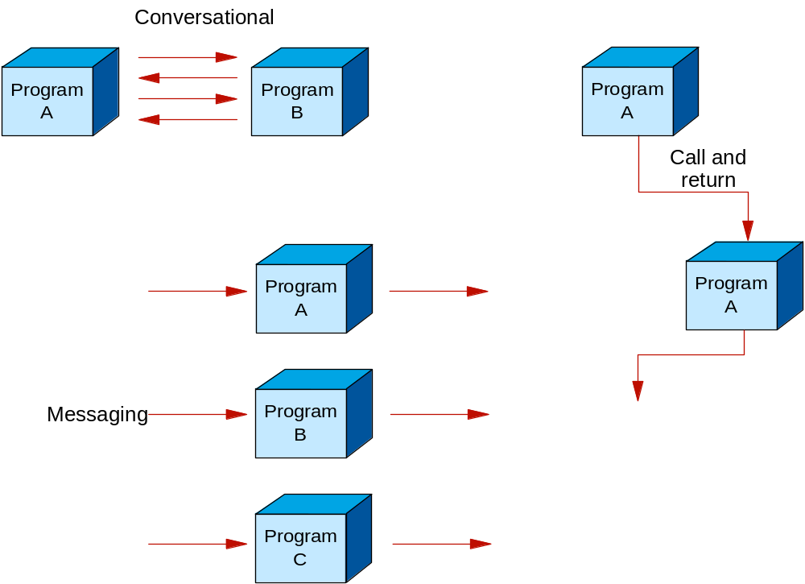
Styles of Communication

Slide 7
Messages
Types of messages:
  Datagram
  Request
  Reply
  Report

Slide 8
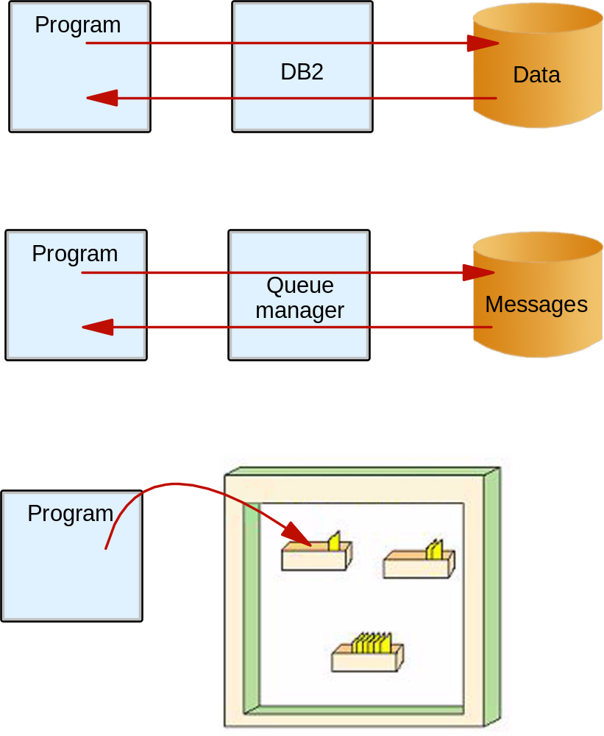
Queue Manager

Slide 9
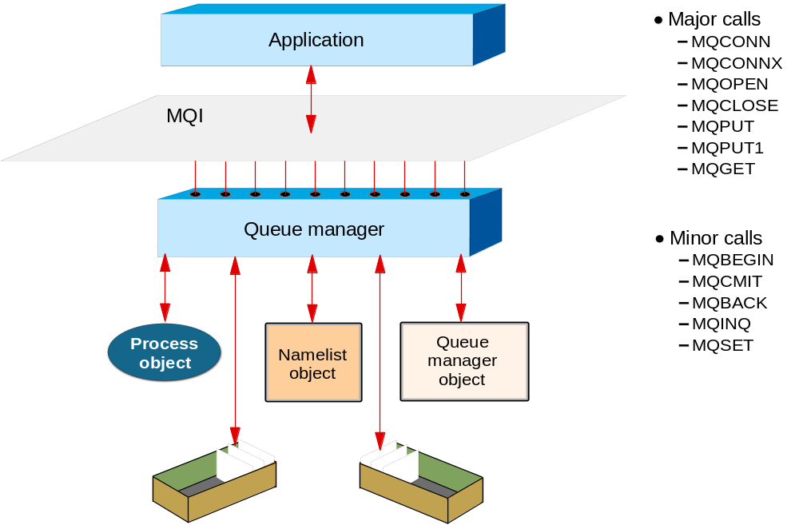
Message Queue Interface (MQI)

Slide 10
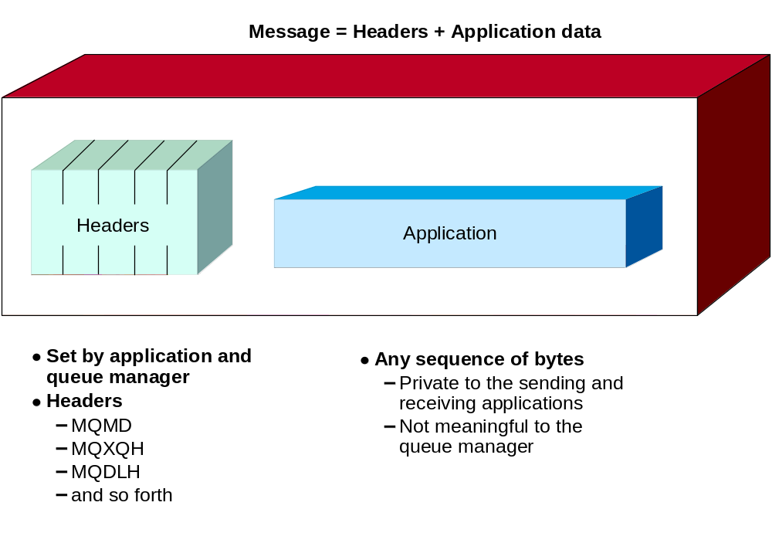
Message layout

Slide 11
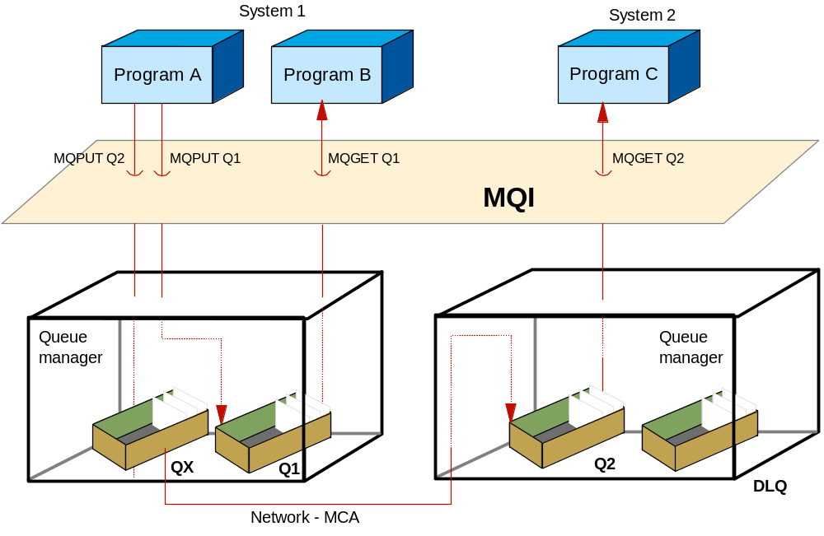
Queue types

Slide 12
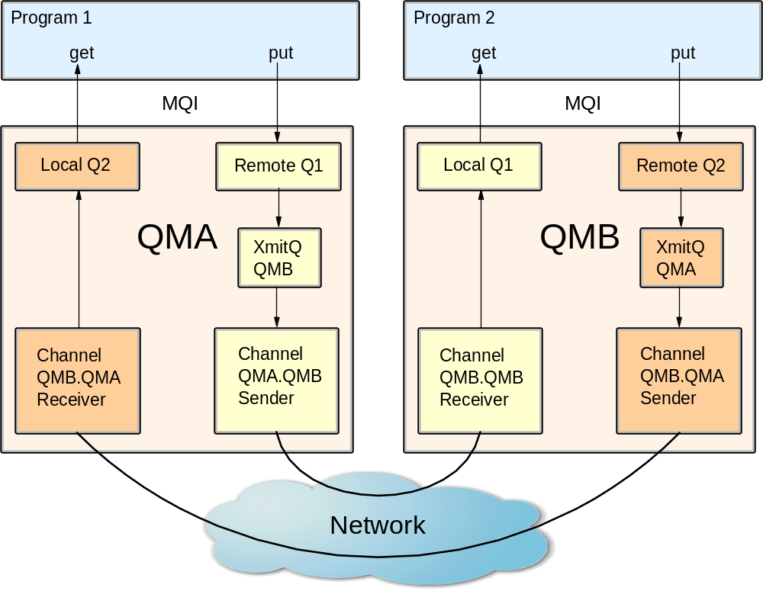
Channels

Slide 13
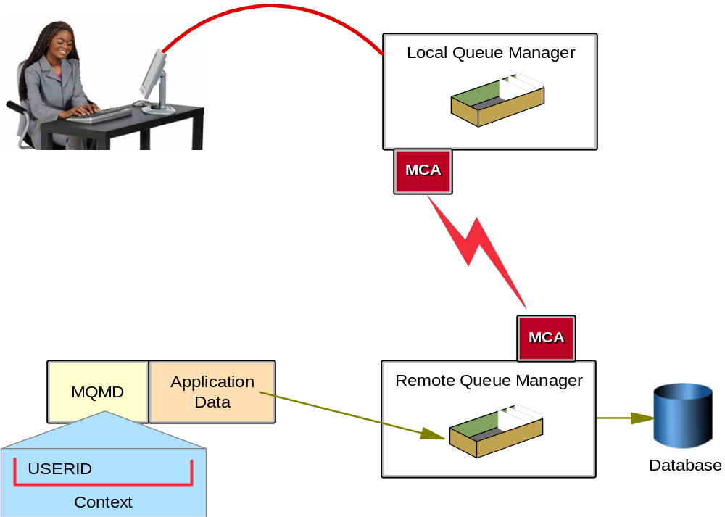
Security

Slide 14
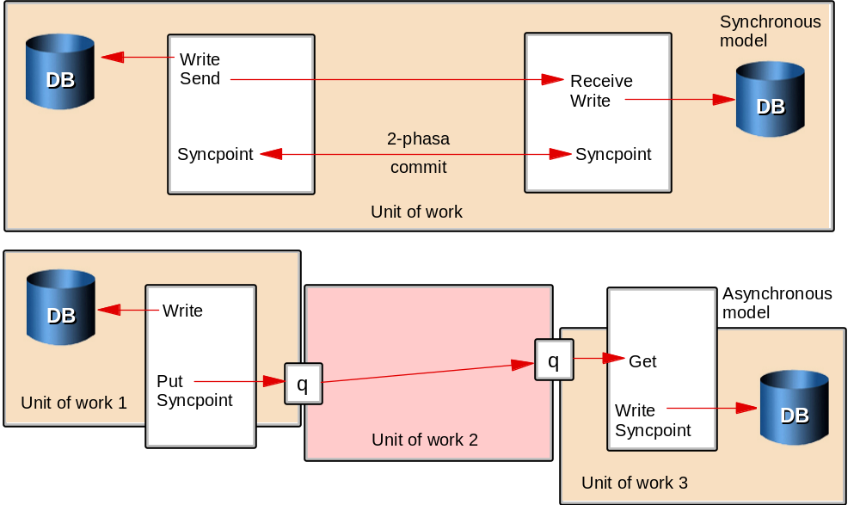
Data Integrity

Slide 15
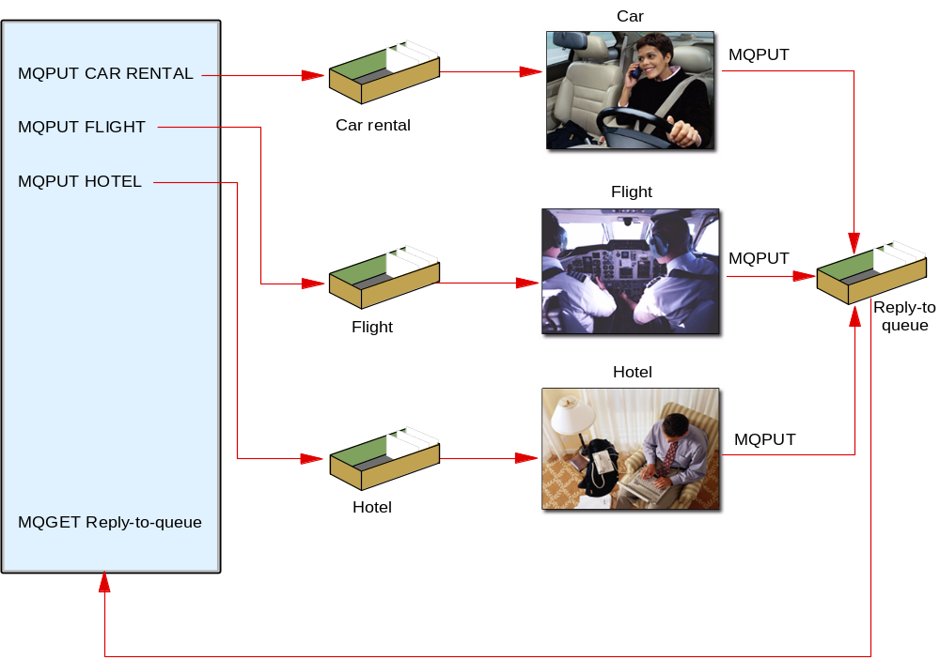
Travel agency example revisited

Slide 16
Interfacing to WebSphere MQ
MQ is available on many platforms
On z/OS it has interfacing to:
  CICS
  IMS
  Batch or TSO

Slide 17
MQ functions
Common application programming interface (MQI)
Assured delivery: messages do not get lost and they arrive only once
No synchronous access needed
Message driven application
Quicker development due to shielding of the network

Slide 18
Summary
Messaging and queuing enables communication between applications on different platforms.
WebSphere MQ is an example of software that manages messaging and queuing in the mainframe and other environments.
With messaging, programs communicate by through messages, rather than by calling each other directly.
With queuing, messages are retained on queues in storage, so that programs can run independently of each other (asynchronously).

